Slide 1
* Workshop Instructions Developing your brand position with your colleagues
Before you Begin Page through this slide show. Whenever you see a yellow Slide Set-Up, follow the instructions to enter data.
Delete the yellow box when completed.
Practice before your Workshop.
Group Slides
Several slides can be filled out with your participants.
Or they can be worked on before your group if you want to streamline the meeting. They include:
Slide 25: Brand Story Characters
Slides 37-39: Your Competitors
Slide 41: Define Your Strengths
Slide 49: Brand Positioning Statement
SLIDE SET-UP
Example
You can delete this slide after you have read the instructions.
RESTART: Each time you see this Restart message after a discussion, click: Slide Show | From Current Slide to restart the show on that slide.
Ready? Go to slide 2 to begin
(example) Restart Slide Show from Current Slide

Slide 2
My Project Here
BRAND STORY WORKSHOP
SLIDE SET-UP
Enter the workshop participant’s names
Enter the name of your project or business name
Participant
Participant
Participant
Participant
Start Slide Show. Click: “SLIDE SHOW| From Current Slide”

Slide 3

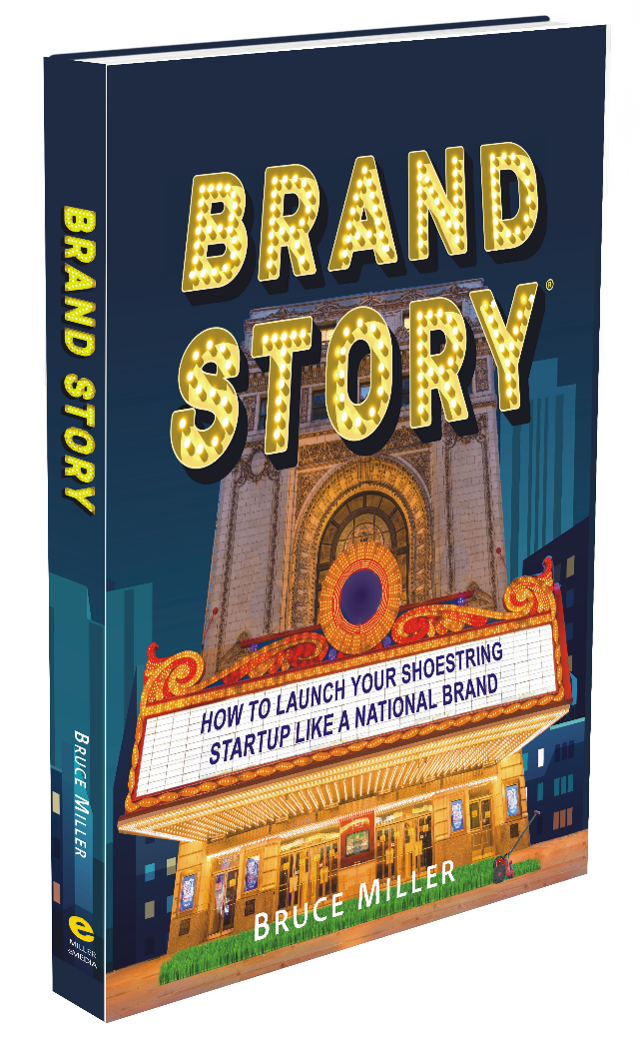



* Introduction
Bruce Miller Miller eMedia Atlanta, GA
Notes:
Thank you for creating a Brand Story Workshop for your business.
/My name is Bruce Miller, the developer of the Brand Story approach to building an effective brand. This method was reverse-engineered from my 20 years as a principal in an Atlanta agency – specifically, to help shoestring start-ups and established businesses position their brand.

Slide 4
* Introduction
How Brands Work
History of Brands
Introduce Brand Positioning
Identify your Target Customer
Define your Strength or Secret Sauce
Establish your Brand Position
Introduce the Brand Platform
Notes:
Today, we’re going to:
/Learn how brands work
/Look briefly at the history of branding, and
/Introduce the concept of brand positioning
/Then, we will identify your target customer,
/Define your brand’s strength or secret sauce,
/Establish your brand position
/And, briefly introduce the full brand platform.

Slide 5
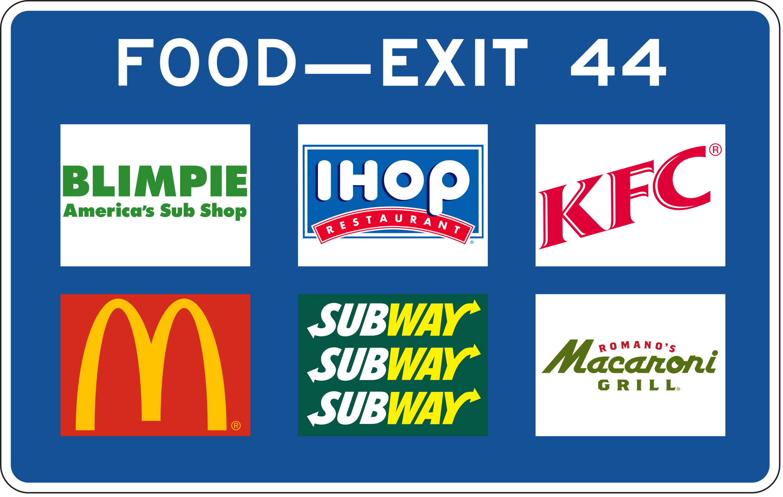
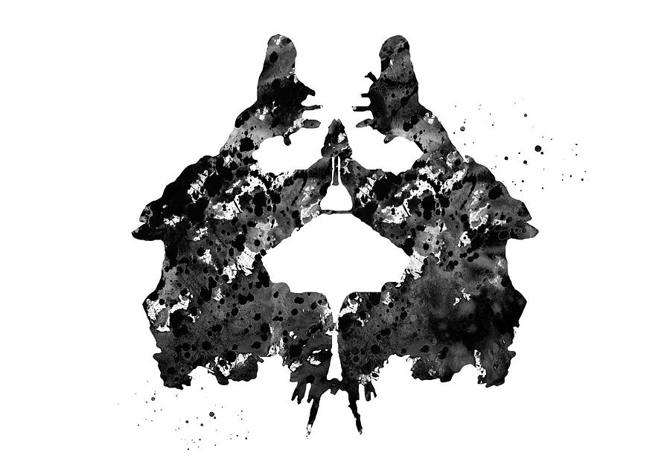
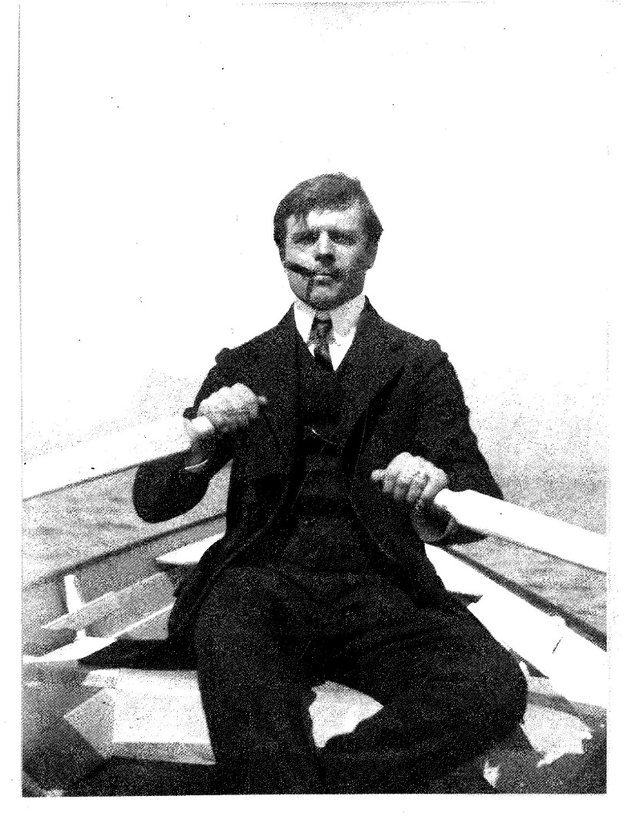

In the mood for psychology?
5
The Rorschach Test
Notes:
To get started, let’s look at brands and how they work.
Imagine you are heading down the highway /and spotted this unusual highway sign. Is it a sad man with a black bushy beard? Or two dancing chickens? What we do know is that these associations are created in your mind. /It’s a Rorschach ink-blot test.
/In 1918, a young Swiss psychiatrist, Hermann Rorschach, invented a test to uncover a patient’s psyche. He discovered that everyone responded to his inkblots differently, but more so, an inkblot elicited a person’s whole way of seeing and feeling.
A brand is not that different from a Rorschach inkblot. Each brand evokes deeply-formed associations of what we like and dislike – what we’re drawn to and what we’re not.

Slide 6

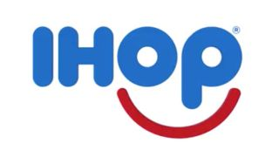
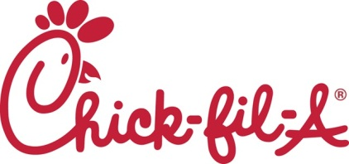
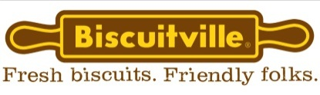
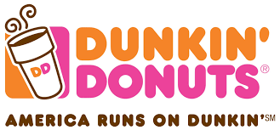
In the mood for coffee?
6
Notes:
A highway sign is like a Rorschach test.
If you want coffee at 70 miles per hour, you don’t have time to weigh your options. You are drawn to one brand over another.
/Why you are drawn to one brand and not another is the mystery we are going to solve today.
If you needed a cup of coffee and saw this sign – /would you pull off the highway? You’re driving too fast to think about it. /Which brand are you drawn to?

Slide 7
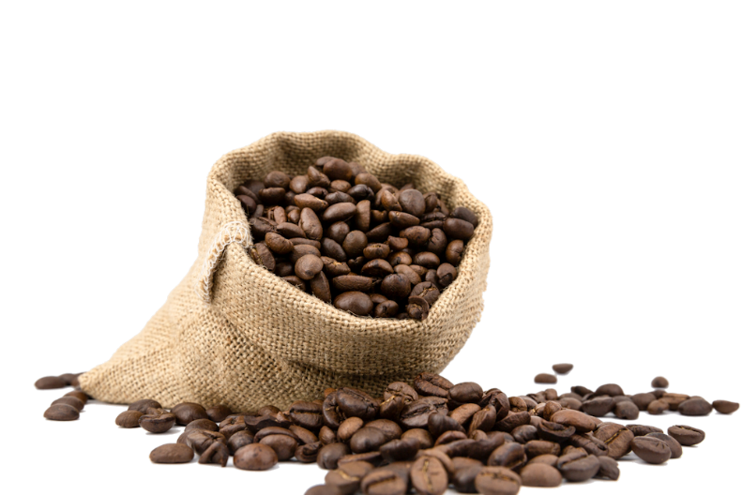
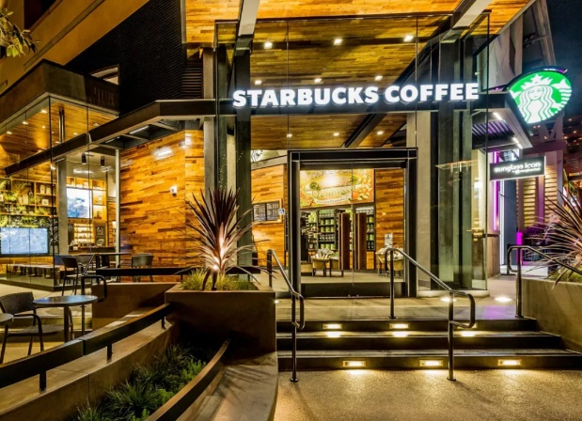
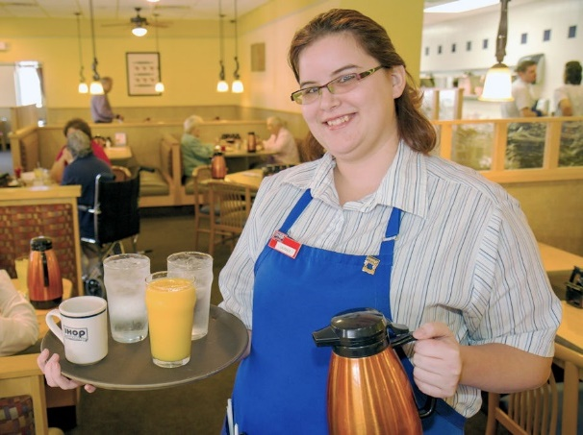
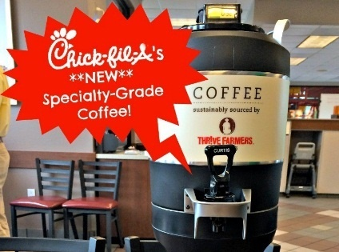
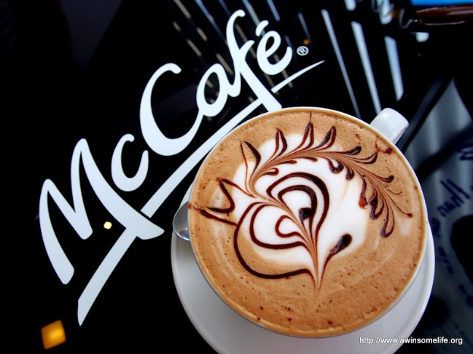
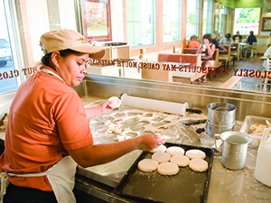
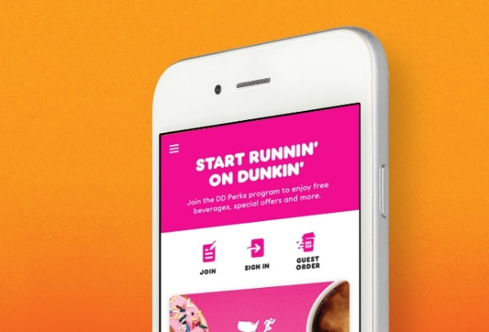

7
Notes:
Each brand sells the same brewed beans, but promises a different experience – a different brand story:
Starbucks offers ambiance, free wifi, and a pumpkin latte.
In contrast, IHOP serves just two coffees – regular and decaf. But you get a cozy booth and a waitress who calls you Hun.
Chick-fil-A was slow to get into coffee. They now serve a brand I helped to develop: Thrive Farmers.
Dunkin lovers don’t need a cozy. They just want better tasting coffee – and fast.
Few people outside of North Carolina know about Biscuitville’s biscuit window.
And McDonald’s? Their customers want cheap, predictable coffee with an efficient drive-through.

Slide 8
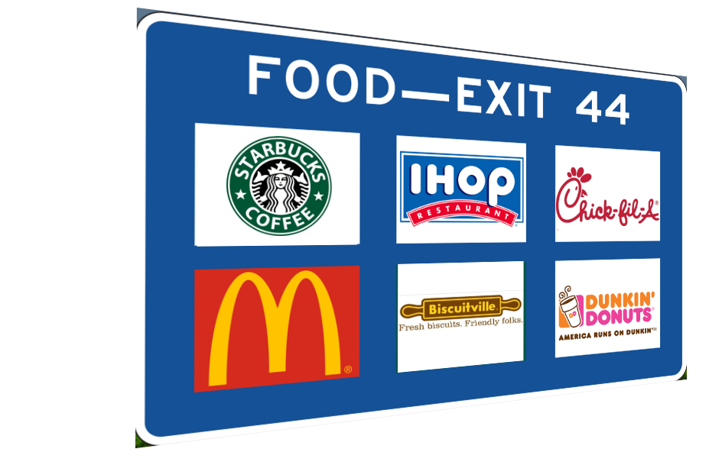



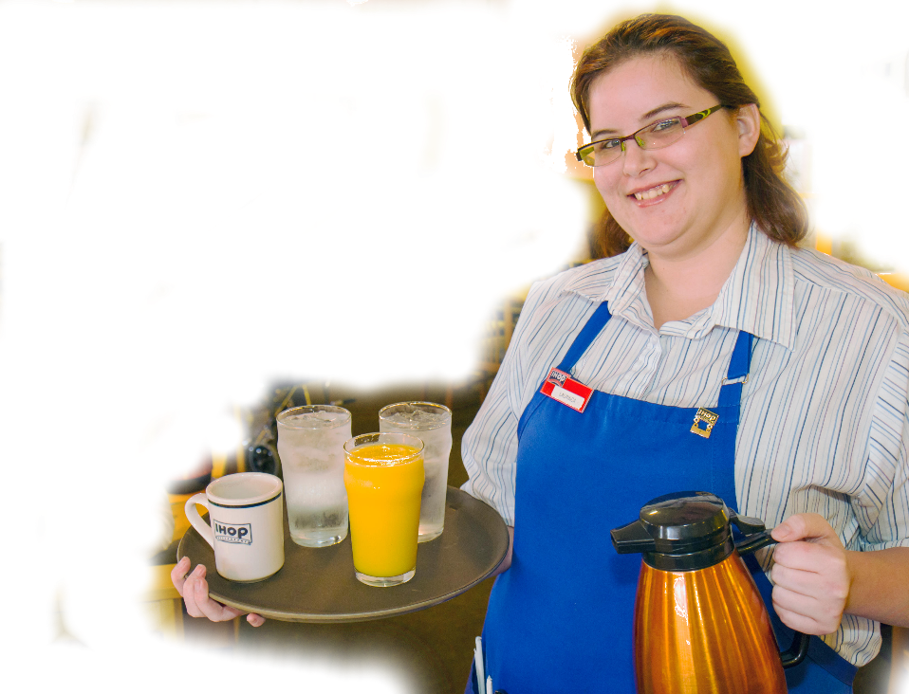
8
* What is a Brand?
A brand exists in the mind of the consumer.
A brand is a set of feelings, perceptions, and associations.
Notes:
So, what is a brand? A brand is not a business name, a logo, or something on a sign.
/A brand lives inside your customer’s mind. /It’s a set of feelings, perceptions, and associations.
For example, “Man, I ‘m tired of driving./ I want to settle into a booth for a cup of coffee. Maybe some orange juice and a waffle.”
These feelings are formed by the promises the brand makes and the experiences customers form over time.
When a brand is successful, it connects its promise to what the customer is looking for.

Slide 9




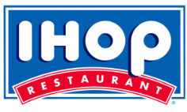
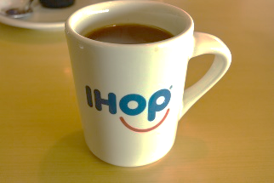

9
* A Brand Position is like having the right key to unlock your target customer.
BRAND POSITION
A brand owns a position in the mind of your target customer.
A brand position may be high or low in terms of price, quality, value, or the brand experience.
A set of feelings and perceptions that your target customer has about your business.
If you don’t solve the customer’s problem in a unique way, there’s no justification for your business.
“This product solves what I need.”
Notes:
A brand position makes the match between what you have to sell and the customer who wants to buy it.
/It’s like having the right key to unlock your customer’s need or desire. /The key fits by owning a position in the mind of your target customer. /For example, “Screw the pumpkin latte; just give me a regular cup of coffee in a comfy booth.”
/Your brand might be high or low in terms of price, quality, value or brand experience compared to other brands. /In this way, a brand position is a set of feelings or perceptions that your target customer has about your business. /It’s a feeling that “this product solves what I need.”
/Here’s the scary truth: If you don’t solve the customer’s problem in a unique way, there’s no justification for your business.

Slide 10
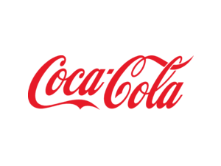
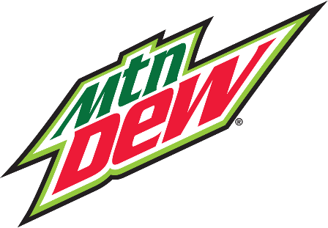


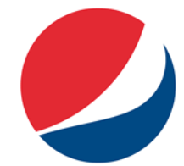
In the mood for [what you sell]?
10
SLIDE SET-UP
Enter [what you sell] in title.
Replace [OUR CATEGORY] with your category.
Replace the soda logos with competitive logos from your field.
Replace My New Brand with your logo or business name if it exists..
[OUR CATEGORY]
My New Brand
COMPETITORS
The PPT will pause.
After discussing go to next slide (11)
Notes:
Just like choosing coffee at 70 miles per hour, your brand must compete in a sea of comparable brands – brands that have more experience, and more money to spend on marketing than you do.
So, how can you break out of the pack? Why would anyone notice your brand or even give you a try?
Your new business must compete on the strength of its brand position. This means that if you try to make your brand attractive to everyone, your business will fail. But if you target your brand to the specific set of customers who need what makes you different, you can win them over.
Take a moment to discuss your feelings about these brands. Restart on the next slide when you’re done.

Slide 11

11
MY BRAND POSITION
The purpose of this workshop is to establish your brand position.
You will determine what makes your product or service unique and identify the target customer who wants what makes you different.
To continue, click: “Slide Show | From Current Slide
Notes:
The purpose of this workshop is to establish your brand position.
/You will determine what makes your product or service unique and identify the target customer who wants what makes you different.
/Think of it like matchmaking. You want to find the customer who will fall in love with your product.

Slide 12
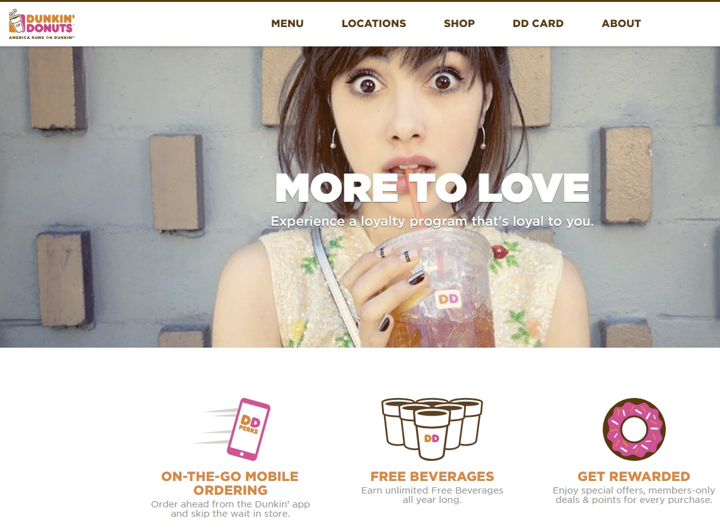
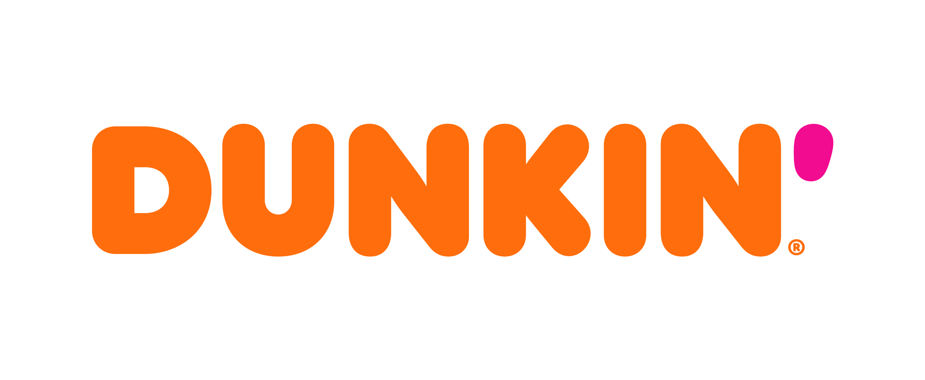
* What is a Brand Position?
12
Notes:
So, what is a Brand Position? /National brands that have strong brand positions, like Dunkin Donuts, are easy to spot.

Slide 13
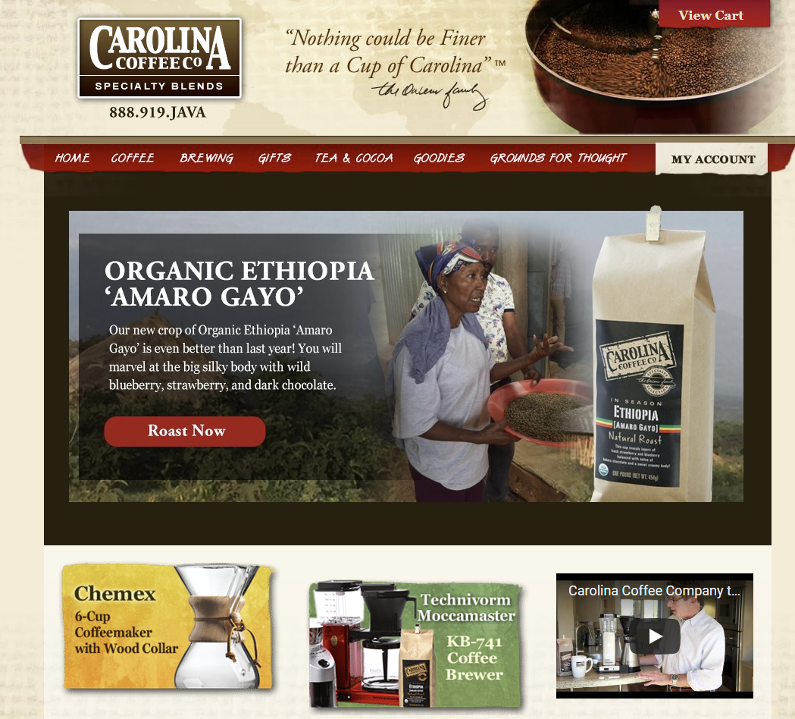
* What is a Brand Position?
13
“Smaller companies and mom & pops” promote product features.
Bigger brands focus on the customer. They solve customer needs.
Notes:
Smaller companies and mom & pops usually don’t have a brand position. /Instead, they promote product features, like this Carolina Coffee Company which promotes the silky body of its organic Ethiopian blend.
/Compare that to Dunkin. /The bigger brands focus on the customer. They solve customer needs. This Dunkin Donut web site doesn’t even mention the word “coffee.” Is that crazy or what?
Instead, Dunkin focuses on customer convenience and loyalty perks. Why? Because Dunkin customers care more about convenience than silky coffee.

Slide 14
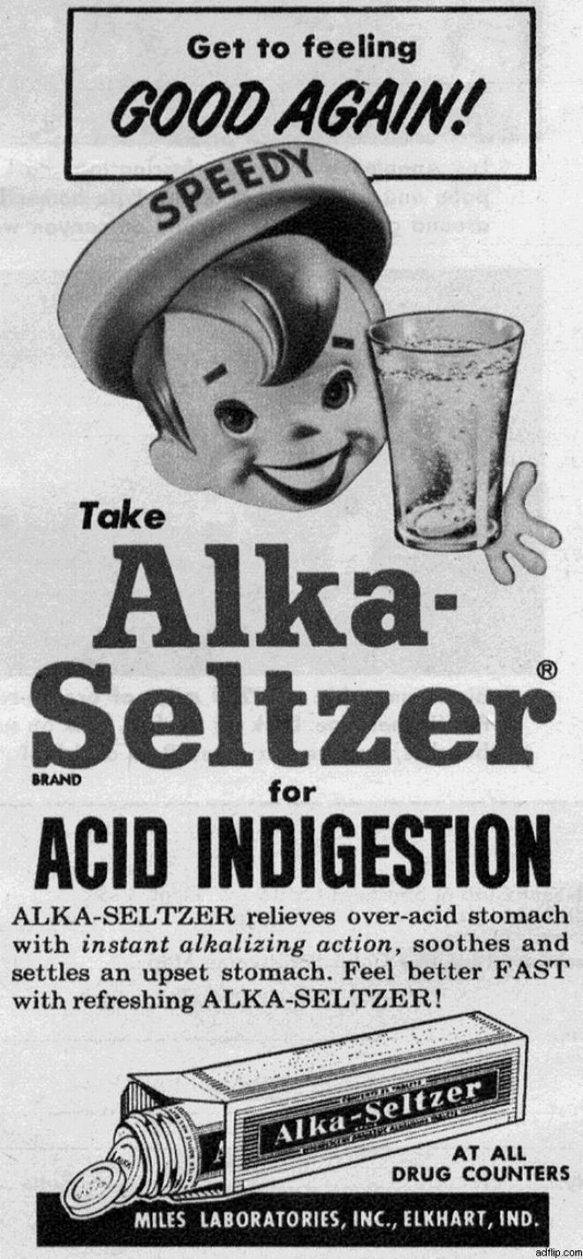
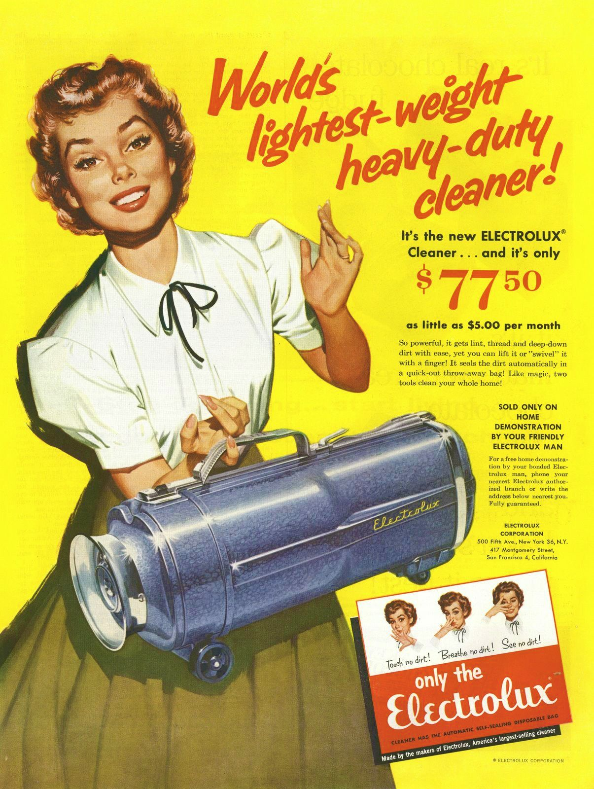
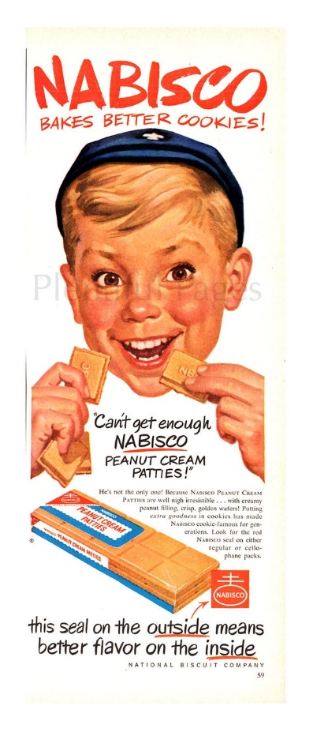
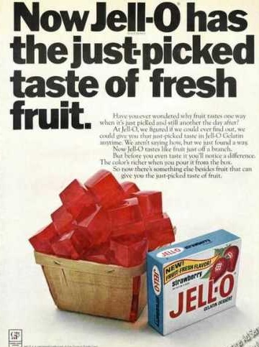
1950s & 60s Advertisers Focused on Product Features
HISTORY
14
Notes:
Let’s look at the history of brand positioning.
/In the 1950s and ’60s, advertisers focused solely on product features. /Their ads promised relief from indigestion, /the lightest vacuum, /great peanut butter flavor, /and fruity-tasting Jello. They felt a superior product would capture your heart.
Product, product, product – but no brand position.

Slide 15
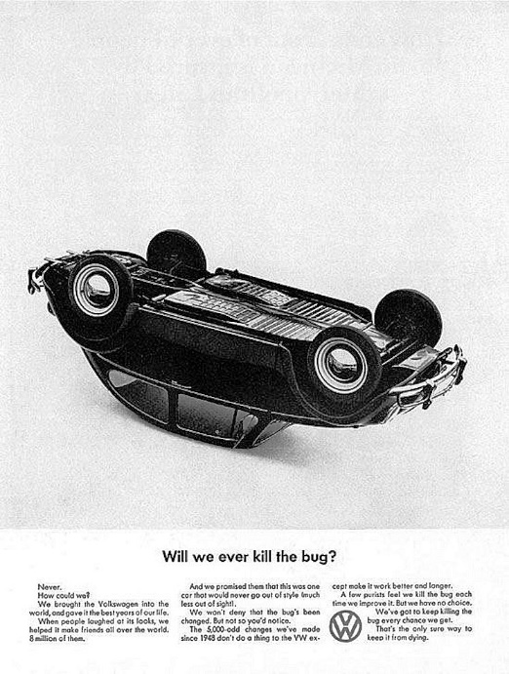
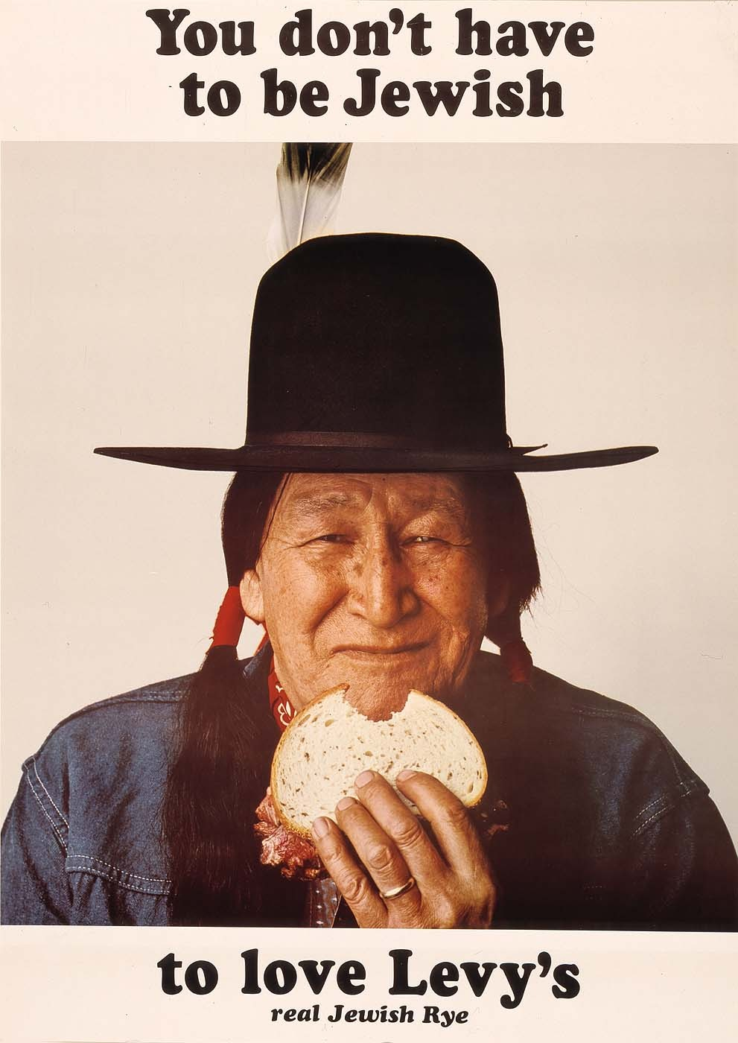
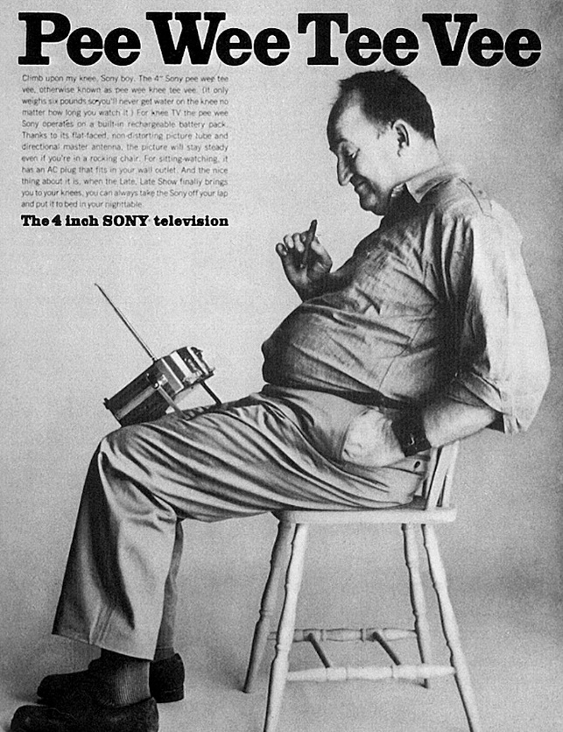
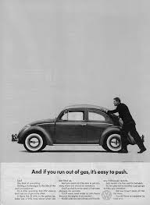
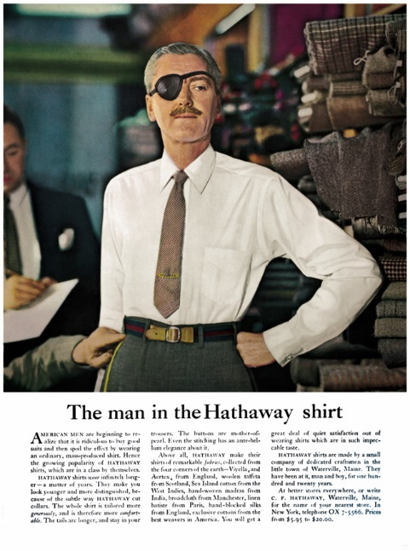
1970s Brand personalities
15
Notes:
In the 1970s, brands started to develop personalities. /Sony was all about tiny electronics. /Volkswagens targeted quirky drivers. /Levy’s Rye Bread celebrated ethnicity. /And the man in the Hathaway shirt spoke to the swash-buckling rogue you dreamed of being.

Slide 16
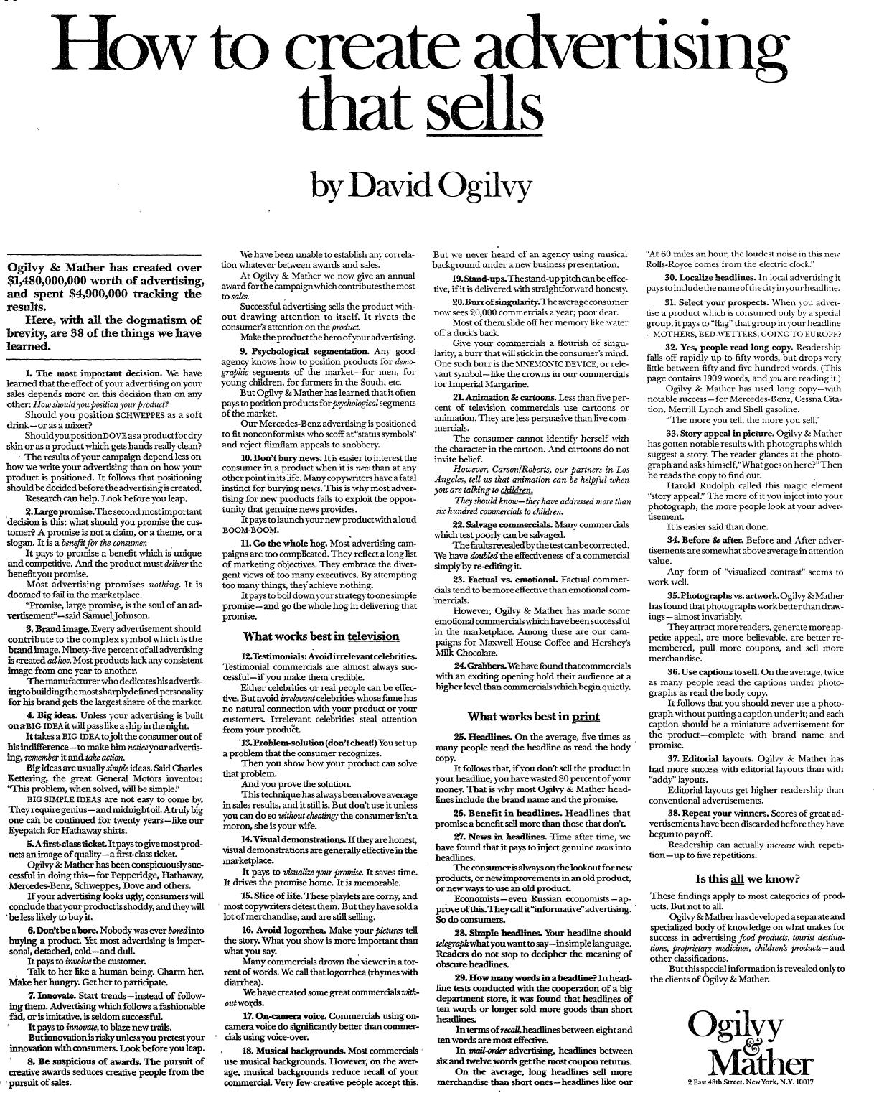
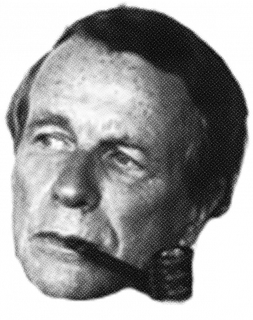

1971: The dawn of brand positioning:
16
Notes:
In 1971, /David Ogilvy, the father of modern advertising, introduced brand positioning. /In a famous New York Times ad, Ogilvy shared his proprietary secrets by publishing the 38 most-important rules he learned during his fabled career.
/Rule number one on Ogilvy’s list: The most important decision you can make that will affect your sales is: “How you should position your Product.”

Slide 17
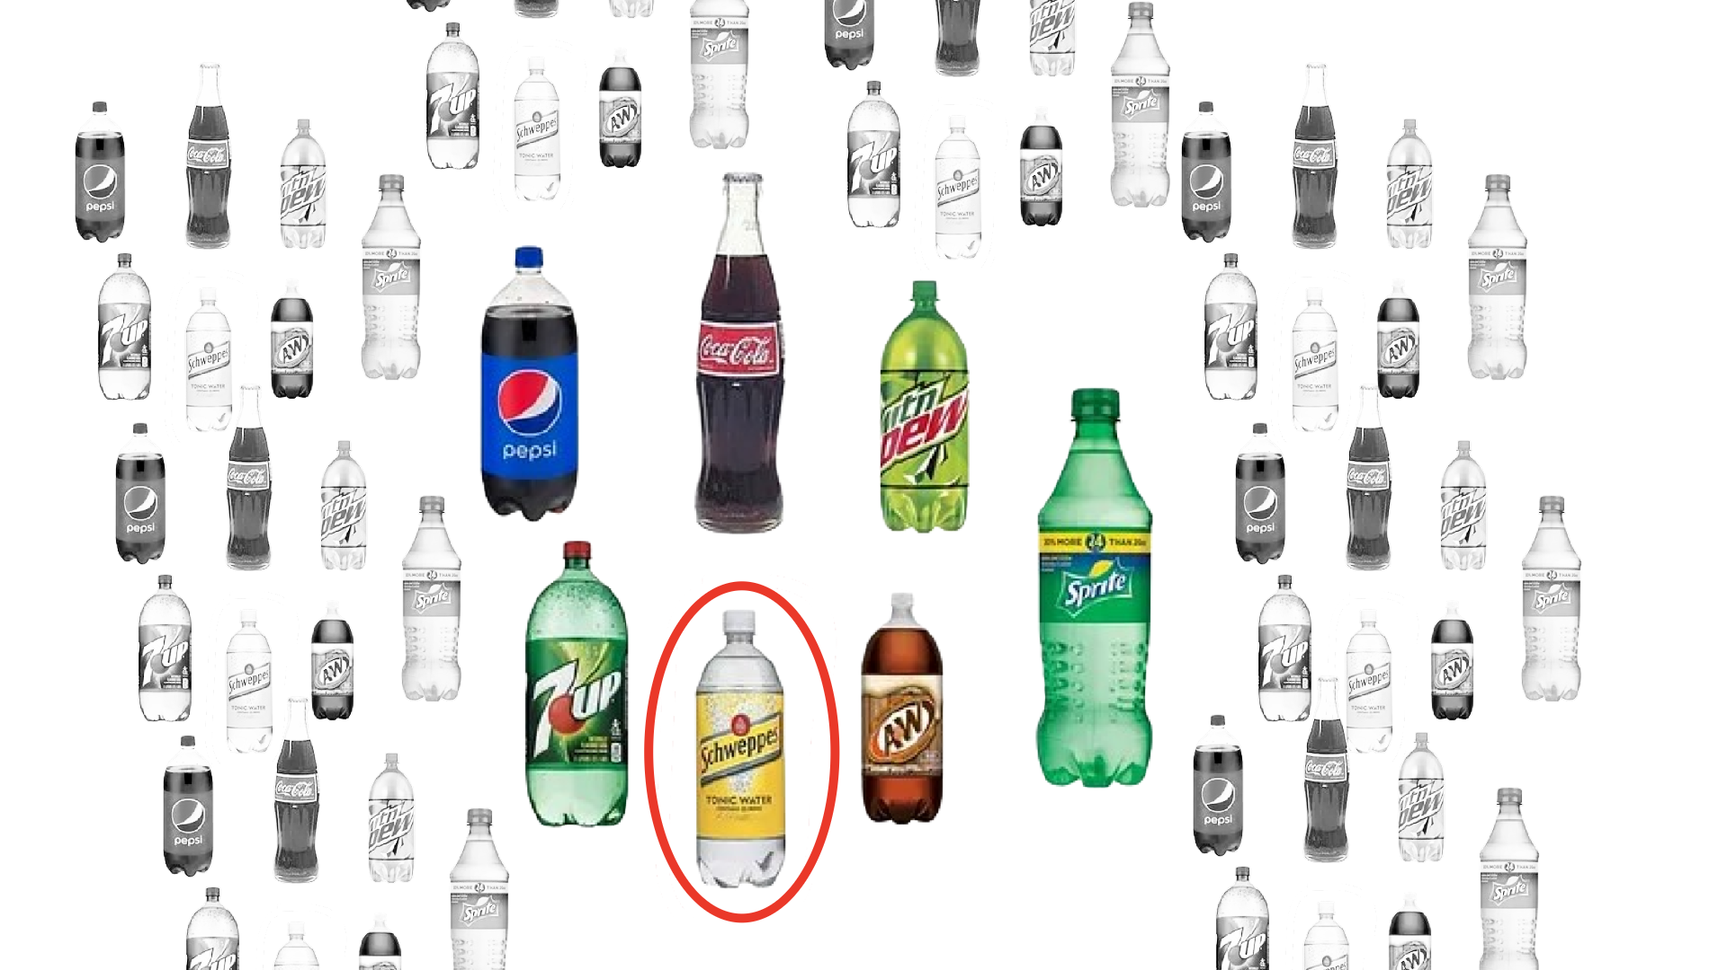
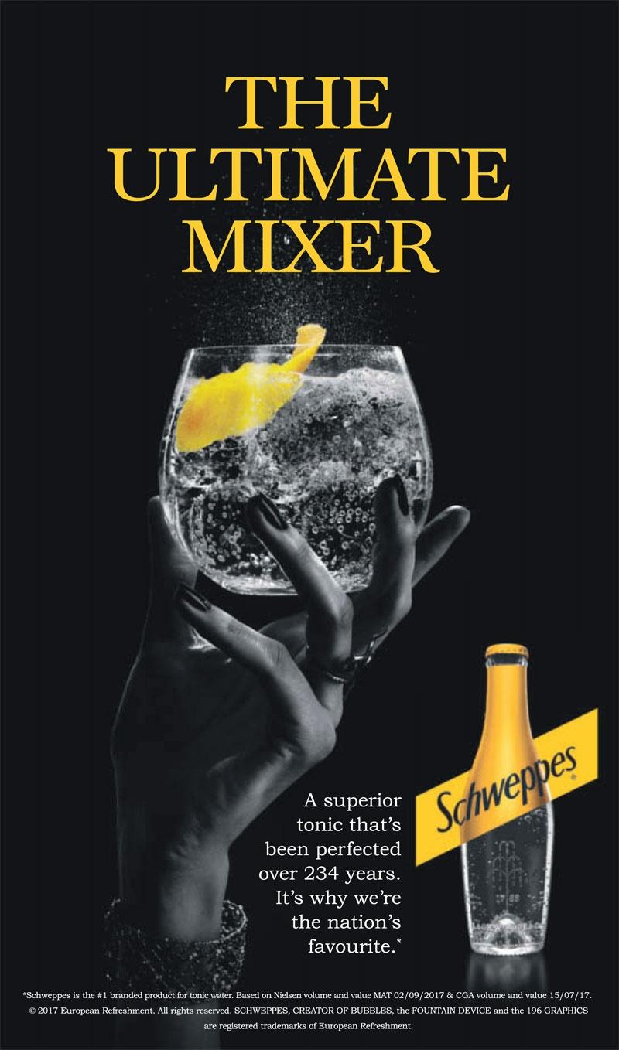
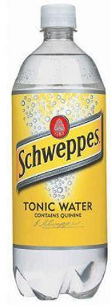
Try to imagine positioning Schweppes today as a soft drink. It would get lost in a sea of soda pop.
17
Ogilvy understood that by positioning Schweppes in a category of its own, Schweppes took command as the leader in its own category.
Notes:
To understand Ogilvy, /Consider Schweppes. Introduced in 1783, Schweppes was the original carbonated drink. It had a two-century head start on Coca Cola and all the rest.
/Try to imagine positioning Schweppes today as a soft drink. /It would get lost in a sea of soda pop.
/Ogilvy understood that by positioning Schweppes in a category of its own – /as the ultimate mixer – Schweppes took command as the leader in its own category – as a mixer. When you go to the store before a party, you instinctively reach for the yellow bottle.

Slide 18
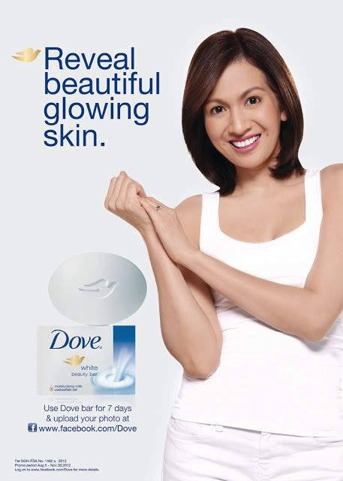
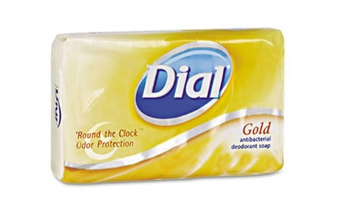
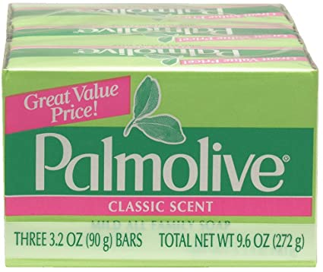
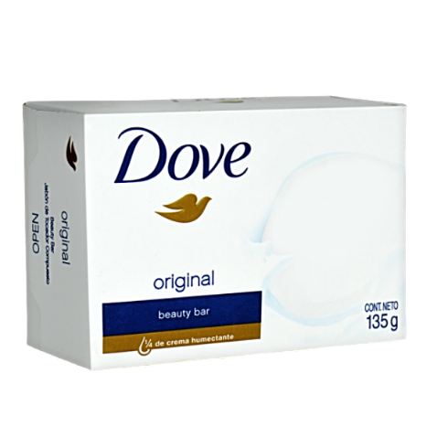
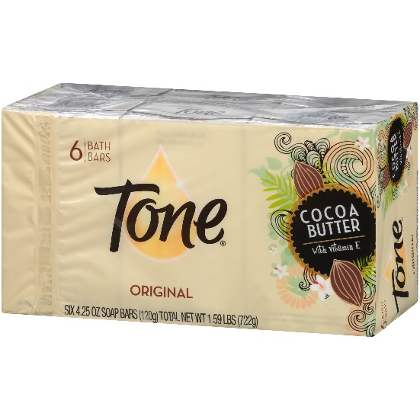
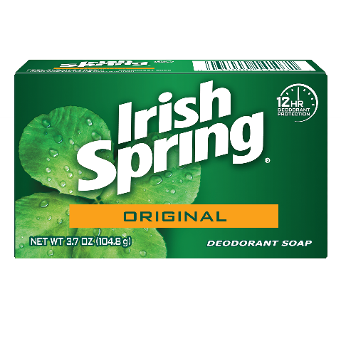

How about bar soap?
18
Positioned for beautiful skin, Dove leads in the category.
Notes:
How about bar soap? /There are dozens of inexpensive soap brands on the market. /Dove soap had a choice: Is it a cleaning soap or a moisturizing soap?
/Dove positioned itself as “moisturizing soap” for glowing skin. Dove isn’t going to sell any soap to guys who work in their shop. /But as a beauty soap, Dove leads in the category and can even charge a bit more.

Slide 19
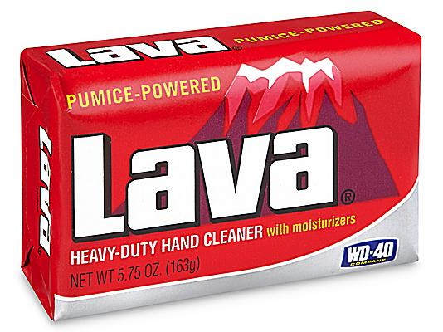

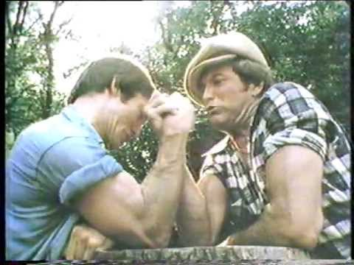

Target Customer
19
“This brand is for me!”
Notes:
Each of these three soap brands targets a specific customer – /the shop worker, /the manly guy, and /the skin-obsessed gal.
None of them tries to capture the entire soap market. If they did, none of these target customers would be able to say, “/This brand is for me.”

Slide 20
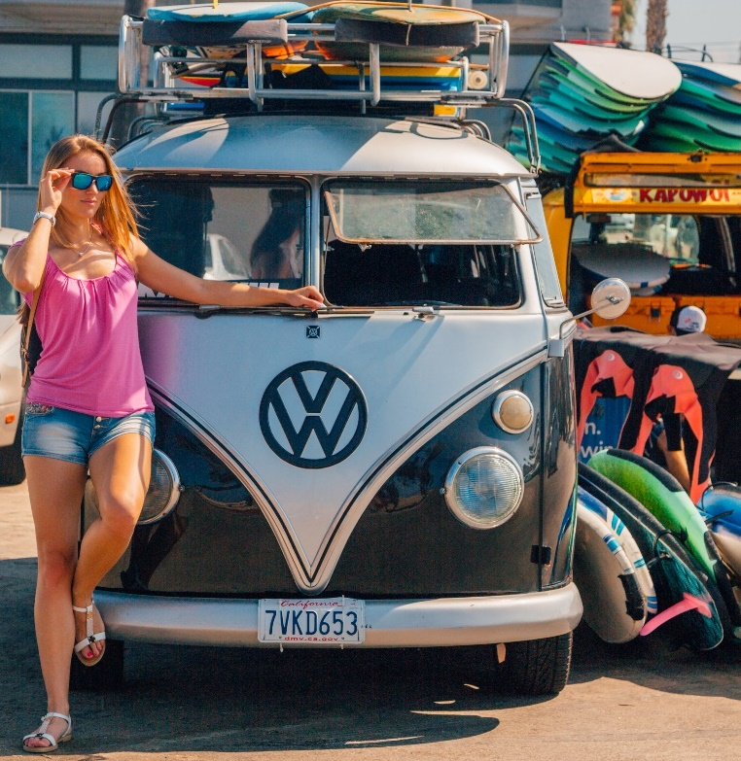
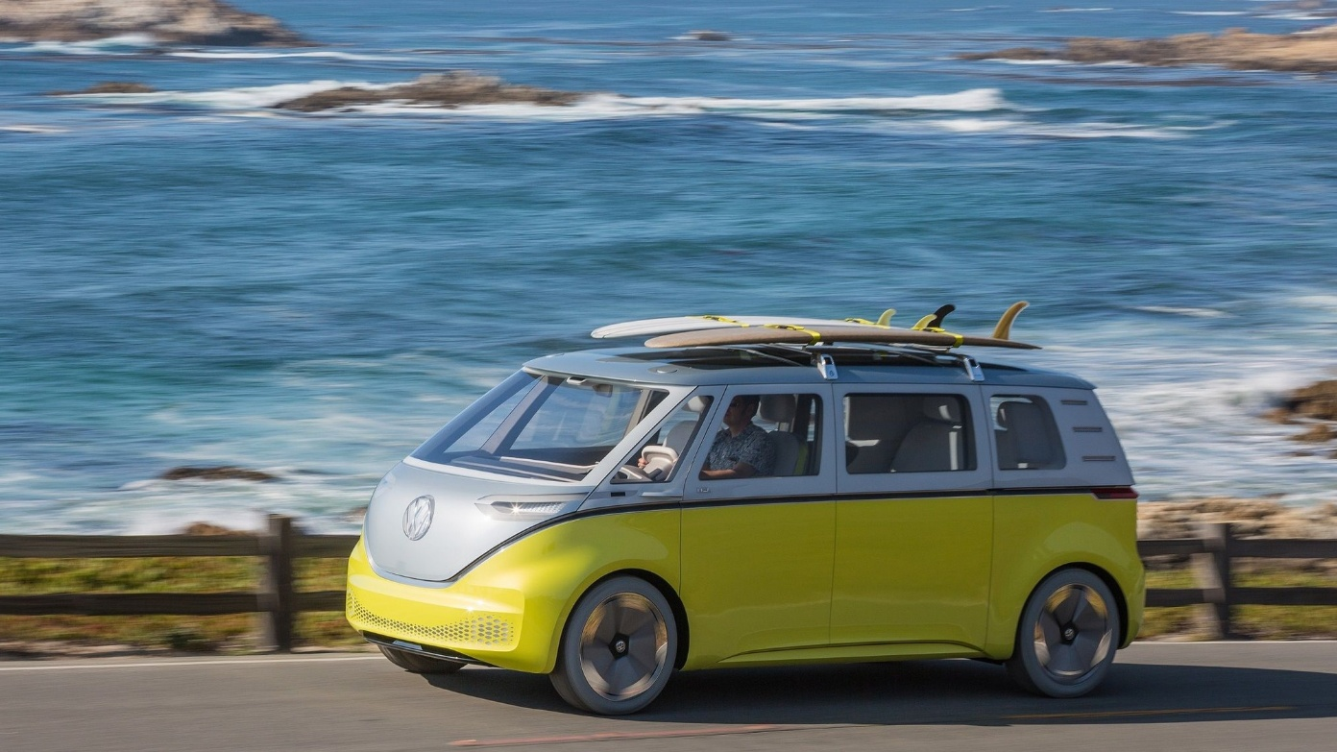
How to connect to your customers
Target Customer
Notes:
In this next section, you will identify your target customer by filling out a customer persona for each type of customer who might be interested in your product.
For example, /would you target the new VW bus to the young person seeking adventure /or the family going on a camping trip?
If you had the data, it might be easier to decide. You will have to use your keen sense of the market you wish to enter.

Slide 21
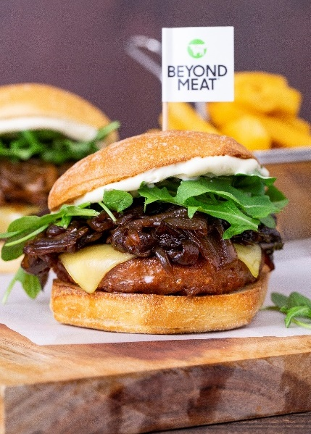


How to connect to your customers
Target Customer
Notes:
You are going to create a customer persona for each person who might be a customer for your product or service. Who is the customer for plant-based meat?
Think of it like a casting call for the lead in your movie. Why would they choose your brand over another?

Slide 22


Notes:
Here’s how customer personas work:
Let’s look at Beyond Meat. You might consider six potential target customers:
/Cardiac Cal is a sales rep. He’s been warned by his doctor: “Cal, you better cut down on meat.”
/Gunner the Mechanic is a confirmed meat eater, but his wife is curious about healthy eating.
/Vegan Vicki is a hardcore vegan who cares about the ethical treatment of animals.
/Mary the Mommy has no ideology around food but seeks out the healthiest food for her family.
/Yolanda is a health nut. She does yoga, drinks kombucha, and studies nutrition avidly.
/And, Climate Clint is concerned about the effects of cattle farming on the atmosphere. Each of these prospects might buy the product, but only one or two are the target customers,

Slide 23

Use the Brand Story form to describe the characteristics of your target customer.
Duplicate the form to create as many characters as you wish.
Notes:
Now it’s your turn. /You will use the Brand Story Character form to describe the characteristics of your target customer. /You will duplicate the form to create as many characters as you wish.
.

Slide 24

Plant-Based Meat | BRAND STORY CHARACTER | “Cardiac Cal”
 | PROBLEM: BMI, cholesterol, glucose, and blood pressure are up. Warned to lose weight and change diet by his doctor for cardiac health. | SEEKING: Transition to a more plant-based diet without major lifestyle changes. | TARGET DESCRIPTION: Mainstream consumers who seek to reduce meat consumption for health reasons.
BACKGROUND: 54-year suburban dad Sales rep for a medical device company Comfortable salary College degree: Marketing | INTERESTS: Watching sports Coaching kids’ soccer Grilling out with friends | BRANDS/MEDIA: Ford Explorer Marvel action movies Nirvana, REM, Pearl Jam | GOALS: Increasing sales commission to save for retirement. Save money to pay for kid’s college.
Notes:
You will start by creating a /nickname like “Cardiac Cal” that slots your character into a category. You can find an image on Google that portrays this brand character.
/Fill out the bottom-row with basic demographics about your character. These demographics should give insights into who this person is as a potential customer.
The top three boxes address your brand position:
/Describe your character’s Problem (and not that they hate their boss) – just the problem or need that your product or service addresses. Place this in the Problem box.
/For Seeking, describe the solution they are seeking. The solution should be solved by your product.
/Summarize this customer in the Target Description. The Target Description is the most important. You will use this description later in your brand positioning statement
The presentation will now pause on the next slide for you to copy and fill out the next slide as many times as you wish for each potential target customer. Restart o

Slide 25

Your Business Here| BRAND STORY CHARACTER | “Nickname here”
 | PROBLEM: problem or need that your product or service addresses. | SEEKING: The solution that should be solved by your product. | TARGET DESCRIPTION: Summarize this customer.
BACKGROUND: Who is this person? What do they do? | INTERESTS: How does this person spend their time? | BRANDS/MEDIA: What kinds of brands does this person purchase? | GOALS: What are their immediate or long-range goals in life?
SLIDE SET-UP
You can fill this out during your Brand Story workshop, or pre-fill before the event.
You can use AI to help (see Learning Guide)
Type into the boxes to enter your customer information.
Duplicate the slide for as many customer personas you wish to consider.
The Target Description will be used in your Brand Positioning Statement
Notes:
The presentation will now pause for you to duplicate and fill out this slide as many times as you wish for each potential target customer. Hit escape to go into Edit mode. Restart on the next slide when you’re done.

Slide 26
Brand positioning
Successful companies that scored big
Restart Slide Show from Current Slide
Notes:
Let’s move on to the main course: We’re going to look at successful companies that scored big through Brand positioning.

Slide 27





Successful positioning
Notes:
Here are five brands that became market leaders through brand positioning.

Slide 28
Successful positioning: Grey Goose
BRAND | POSITION | TARGET CUSTOMER | THE PAY-OFF
Grey Goose Vodka |  | Status drinkers who want to flaunt their discerning palate and discretionary income. | Seven years after its 1997 introduction, Grey Goose was purchased by Bacardi for more than $2 billion— all from leveraging an award into a brand position..
The number one tasting vodka in the world
Notes:
Grey Goose was launched in 1997 as a luxury vodka for the American marketplace.
One year later, Grey Goose won a competition sponsored by the Beverage Tasting Institute. Rather than stick a medal on the back of the label, Grey Goose positioned itself as /the Number One Tasting Vodka in the World. That’s pretty ballsy.
Seven years after it’s introduction, Grey Goose was purchased by Bacardi for more than $2 billion— all from leveraging an award into a brand position.

Slide 29
Successful positioning: BMW
BRAND | POSITION | TARGET CUSTOMER | THE PAY-OFF
BMW |  | High-performance luxury car aficionados. | By promoting high performance with smaller, more nimble vehicles, BMW now outsells Mercedes — the most famous luxury brand in the world.
The Ultimate
Driving Machine.
Notes:
Mercedes Benz was long established as the number one luxury car.
As a much smaller upstart, BMW cleverly /positioned itself as the Ultimate Driving Machine for luxury car owners who also sought high-performance.
By promoting high performance with smaller, more nimble vehicles, BMW now outsells Mercedes — the most famous luxury brand in the world.

Slide 30
Successful positioning: Energizer
BRAND | POSITION | TARGET CUSTOMER | THE PAY-OFF
Energizer |  | Value-driven shoppers who prefer name brands | Energizer’s bunny has you convinced that its battery lasts longer.
It Keeps Going, and Going, and Going.
Notes:
When it comes to long-lasting batteries, Duracell is the durability king.
But Energizer successfully chipped away at Duracell’s commanding position with its Bunny that/ “Keeps Going, and Going, and Going.
For Value-driven shoppers who prefer name brands, Energizer’s bunny has you convinced that its battery lasts just as long, or longer, than Duracell.

Slide 31

Successful positioning: Barilla
BRAND | POSITION | TARGET CUSTOMER | THE PAY-OFF
Barilla |  | Italian food foodies who love Italy. | Barilla became the number 1 pasta in America after a mere three years in the U.S. market.
Italy’s No. 1 pasta.
The Ultimate Commodity?
Notes:
Dried pasta is the ultimate commodity. A national name brand like Barilla is indistinguishable from a cheaper grocery store brand.
By positioning itself /as Italy’s Number One Pasta, Barilla captured the hearts of Italian food foodies – people who love Italy, even if they’ve never been there.
What’s more, Barilla became the number one pasta in America after a mere three years in the U.S. market. Even more telling about the power of positioning, Italy’s number one pasta is made in Iowa.

Slide 32
Successful positioning: Dyson
BRAND | POSITION | TARGET CUSTOMER | THE PAY-OFF
Dyson |  | Gadget nerds with discretionary income | After two years in the market, Dyson’s high-tech vacuum captured the #2 position against Hoover, a 100-year old brand that is synonymous with the word “vacuum.”
The first vacuum
cleaner that doesn’t lose suction.
Notes:
All vacuums use suction to clean floors. But Dyson built a brand that made better suction its brand position: /The first vacuum cleaner that doesn’t lose suction.
Dyson targets gadget nerds who have the income to spend on a high-tech vacuum.
After two years in the market, Dyson captured the #2 position against Hoover, a 100-year old brand that is synonymous with the word “vacuum.”

Slide 33






Identify your strengths
Brand Position
Notes:
We looked at some brand positioning success stores. Now, let’s identify your unique strength -- your brand differentiator.
/Whether you have a Blue Magic whitener, /or taste Better than Home Baked, /or have more doctors smoking your brand than competitors, your brand will offer unique strengths – /something faster, bigger, or better -- than other brands.

Slide 34


Your Secret sauce
Brand Differentiation
Notes:
Brand strategists call this unique strength your “Secret Sauce.”
/Did you realize that McDonald’s secret sauce is basically mayonnaise with a little French dressing? But by making it a Special Sauce, it became special.
Let’s determine what makes your brand special.

Slide 35

competitors
Where do you shine?
Notes:
First, let’s look at your competitors. On the next few slides, let’s examine businesses that sell a similar product or service to yours. You will find direct competitors and list their strengths and weaknesses .
Use as much time as you need to discuss what these businesses are doing right and where they leave the door open for you to compete.
/For practice, let’s pretend you’re opening a doggie daycare and dog wash.

Slide 36



Spot for Dogs
Strengths
Cool 1950s warehouse and Airstream trailer
Hip, dog-loving attitude
Plenty of room for running around
Dog wash
Colorful brand
Easy parking
Two locations
Great neighborhood
Weaknesses
No outdoor space
No retail sales
Steep prices!
$55 overnight
$28 daycare
$40 wash
No self-serve wash
Missing a true brand story
No people in their photos
No classes
Notes:
Here are the strengths and weaknesses for Spot for Dogs. It’s a brand-new doggie daycare in my neighborhood.
You and your team will use the next three slides to discuss your competitors' strengths and weaknesses. You’re looking to discover where you can gain traction against the competition in your market:

Slide 37

Competitor 1
Strengths
Cool thing 1 about this brand
They’ve got this one covered, too.
Another cool thing.
Etc.
Weaknesses
They are missing the boat here.
Another weakness where we can do better
SLIDE SET-UP
Find 3 or more direct competitors to discuss on the next 3 slides. You can use AI: [PROMPT: “Find three direct competitors for TYPE OF BUSINESS, SERVICES, SIZE, LOCATION, ETC.]
Enter their strengths (where they excel in your category).
Enter their weaknesses (where you think you can do better)
If you want more than 3, duplicate the slide as needed.
After you discuss, restart on Slide 40.

Slide 38
Competitor 2
Strengths
Cool thing 1 about this brand
They’ve got this one covered, too.
Another cool thing.
Etc.
Weaknesses
They are missing the boat here.
Another weakness where we can do better

Slide 39
Competitor 3
Strengths
Cool thing 1 about this brand
They’ve got this one covered, too.
Another cool thing.
Etc.
Weaknesses
They are missing the boat here.
Another weakness where we can do better

Slide 40



Solving Needs: Define Your Strengths
Restart Slide Show from Current Slide
Notes:
Now that you’ve looked at the strengths and weaknesses of the competition, let’s see where you stand out.
You’re going to use this clipboard to discuss where your brand may be better or unique.
/Suppose you were building the brand for Tesla. Compared to the competition, /Tesla delivers better range (which is enhanced functionality). /And, as a luxury brand, Tesla used to convey status – before its controversial ethics.
/In comparison, a Kia EV3 stands out with better range, bigger screen, and lower price
On the next slide, you will identify the strengths of your brand.

Slide 41

Solving Needs: Define Your Strengths
STRENGTH
Better Price
Greater Convenience
Enhanced Functionality
User Experience
Company Expertise
Conveys Status
Other
SLIDE SET-UP
From your chosen strength(s) enter into the form
My New Brand
Notes:
Let’s pause here. List your strengths for any of the categories where you excel. Feel free to create your own categories.
After your done, decide which strength or strengths will become the centerpiece of your brand.
Press escape to enter edit mode. Then restart the presentation on the next slide.

Slide 42
brand position
Aligning the brand to customer needs
Restart Slide Show from Current Slide
Notes:
Good work. Let’s put it all together to create your Brand Positioning statement. This internal statement will guide your marketing and messaging.

Slide 43


brand position
Aligning the brand to the customer
Notes:
When a brand position works well, it can be so obvious that you don’t even notice it. /For example, the brand position explains why Vespa and Harley target very different customers. One brand is sweet and playful, and the other speaks to your inner rebel. A successful brand position seems completely credible and natural.

Slide 44





* The Brand Position Must Be Clear
Notes:
Compare the brand positions of Jimmy Johns and Firehouse Subs. They both offer subs and they both are credible. One focuses on fast and the other celebrates firefighters.
There’s a customer for each.

Slide 45




* A Brand Positioning Statement
45
For twenty-something guys who live in dorms or work in cubicles…
And who need to satisfy immediate hunger when there’s little time to eat and no inclination to cook…
Only Jimmy John’s delivers subs so freaky fast, we start preparing your order before you’re even off the phone.
We’re so committed to speedy delivery, if we can’t get it to you in 12-15 minutes, we’ll make it up to you.
Who is our Target Customer? Middle of the bell curve
What are their needs? Problem they seek to solve
Secret Sauce: How does our product uniquely solve their needs?
Proof: Give your customers a reason to believe!
Notes:
Now it’s time for the main event. Creating your brand positioning statement. Let’s practice with a fictious brand statement for Jimmy John’s.
Who is the Jimmy John’s target customer? Yes, there are old people and young people, hipsters and moms, and businessmen who all eat Jimmy John's sandwiches. But who is in the absolute middle of the bell curve? Who should their advertising target? Let’s put: /“For twenty-something guys who live in dorms or work in cubicles… You might argue that we’re cutting all those other people out of the picture. We’re not stopping your mom from buying a sandwich, but the brand will be built around the young dude who identifies with “freaky fast.”
What are their needs? Well, that’s easy:/ “And who needs to satisfy immediate hunger when there’s little time to eat and no inclination to cook… In other words: “I need a sandwich right now and it doesn’t need to be pretty.” Anybody ordering Jimmy John’s is probably not a foodie.
What’s their secret sauce? What makes Jimmy John’s unique? It’s all about speed and convenience. Speed is too generic to be a secret sauce. /Let’s put “Only Jimmy John’s delivers subs so freaky fast, we start preparing your order before you’re even off the phone. I know someone who worked for Jimmy John’s who told me this is the case,… but I can't verify it.
And finally, number 4: What’s the proof that you really deliver? /Let’s put: We’re so committed to speedy delivery, if we can’t get it to you in 12-15 minutes, we’ll make it up to you.
Don’t believe it? /Here’s Jimmy John’s to a customer on Twitter: “I hate messing up, but love making it right. They stand by their promise.

Slide 46

* Brand Positioning Exercise
1. Target customer:
2. Needs:
Target Customer: Who is our customer?
What are their needs? Problem they seek to solve
Secret Sauce: How does our product or service uniquely solve their needs?
Proof: Give your customers a reason to believe!
3. Secret Sauce: “ONLY…
4. Proof
Notes:
Now it’s your turn.
The Brand Positioning Statement includes four parts:
/Who is our target customer?
/What is the problem or need they hope to solve?
/What is our Secret Sauce? How does our product or service uniquely solve their needs?
/And finally, what proof do we have that we deliver on our promise. Give your customers a reason to believe.
It seems simplistic, but it’s not. The positioning statement will guide your brand into the marketplace.

Slide 47



* Our Target Customer
Who we pitch
Target Customer Descriptions
TARGET DESCRIPTION1
TARGET DESCRIPTION2
Etc.
Enter your sweet spot – For the customer at the top of the bell curve.
Notes:
Before we fill out your brand positioning statement, let’s pause to fine-tune your target customer:
/In the gray box, replace the yellow text with each of the Target Descriptions you created in your Brand Personas beginning on Slide 25.
/In the blue box, create a description that summarizes the sweet spot for your target customer – the customer -- or customers -- who will represent the bulk of your business. /The customers at the top of your bell curve.
The presentation will now pause. Hit escape to enter edit mode, then restart the Slide Show on the next slide.

Slide 48





* Putting it all together…
Target Customer Description
Customer Problem and Seeking
Your unique solution or Secret Sauce
Gather these three descriptions, then Restart Slide Show on the next page
Notes:
Now it’s time to put all the pieces together into your Brand Positioning Statement.
/Gather your Target Customer Description, /the Customer Problem and what they are Seeking, /and your unique solution or Secret Sauce. Pull these from your work in the preceding sections. You will enter these into the formula on the next page.
The presentation will pause while you gather these descriptions.

Slide 49

* Brand Positioning Statement
For (target customer description)…
…who (describe the problem or need they are seeking to solve)…
Only (your company product/solution or secret sauce description solves the problem described in #2)
Describe any proof, results, metrics, satisfaction scores as evidence that your brand delivers.
Target Customer: Who is our customer?
What are their needs? Problem they seek to solve
Secret Sauce: How does our service uniquely solve their needs?
Proof: Give your customers a reason to believe!
Fill out your Brand Posiiton, then Restart Slide Show on Next Slide
Notes:
Use this form to develop your brand positioning statement. Pull in the work you have done in the previous sections and replace the yellow text. It doesn’t have to be eloquent. Let it be sloppy. You can tighten it up once it hangs together.
This is not marketing copy.
Think of it like a recipe. It includes all the ingredients that will guide how you present your business to the world.
Pay special attention to the word “Only” in number 3, your secret sauce. When you say “only,” that’s your special power in the marketplace.
The presentation will pause. Hit escape to enter edit mode and build out your brand positioning statement.

Slide 50

Connecting to the customer
Brand Story
Restart Slide Show on This Slide
Notes:
Congratulations! You have positioned your brand. You now have a special power that only the most successful national brands possess: a brand position that connects with your customers.

Slide 51


Brand Platform
Brand Story
Notes:
Your brand position will guide all the component parts of your brand. This is your brand platform, which we will discuss in Chapter 12.

Slide 52

touchpoints
Brand Story
Threads, TikTok, Instagram
Notes:
The course will also show you how to implement your brand in the marketplace through touchpoints. Every time someone encounters your brand, it should point to your brand position – your brand story.

Slide 53








Notes:
Thank you for doing the good work by building a well-positioned brand. Your efforts will be rewarded many times over. And hopefully, you will join the ranks of the many shoestring start-ups that have gone on to achieve success in the marketplace.

Slide 54

NOW PLAYING Brand Story®

