Slide 1

Chatty
Your Personal Receptionist ON DEMAND
BRAND PLATFORM

Slide 2
Who is the Brand for? What is the Brand product? How is the Brand differentiated? What is the reason to believe?
* Brand Positioning Statement
2
Target customers
For start-ups, entrepreneurs, and growing businesses,
Problem they seek to solve
who wish to project a professional image without incurring the overhead or financial commitment of a hired, full-time position…
Our unique approach (Secret Sauce)
Only CHATTY RECEPTION offers an On-Demand Personal Receptionist service that…
MAKES CUSTOMER SERVICE AFFORDABLE by not charging a base rate or minimum,
LEVERAGES THE WORLD-CLASS INFRASTRUCTURE of a PACE-SRO-accredited call center,
PROJECTS A PROFESSIONAL IMAGE that impresses customers, captures leads, and closes more deals, and
REFLECTS our Christian culture of SERVICE, driven by our passion for fostering human connections.
How we do it
Proof that it works
The success of our approach is evidenced by the satisfaction of our customers, as well as the quality and loyalty of our employees.

Slide 3

3
* Target Customer – The Top of the Bell Curve of people who need your product
Who is the most likely user of our service?
Our ideal customer seeks a professional business image but is either too busy to take calls or too cash-conscious to hire a full-time receptionist.
“I can focus on my work while CHATTY handles my calls
SOLO ENTREPRENEURS
We are well-suited for start-ups, solo entrepreneurs, small and growing businesses, including
Solo Attorneys and Law Firms
Real Estate Agencies
Contractors
Residential Services
Financial Counselors and Brokers
Insurance Agencies
Graphic Designers
Marketing & PR Firms
Business Consultants
Solo Architects
Property Managers
Chiropractors
Massage Therapists
Event Planners
Independent IT professionals
Virtual Offices
Certified Public Accountants
Non-Profits
Home-Based Businesses

Slide 4

4
* Brand Concept
The Market-Penetrating Missile
Your Personal Receptionist – On Demand
On Demand is the single idea that always comes to mind when someone encounters your brand. It is the core message your brand consistently communicates across every touchpoint.
Only Chatty has NO MINIMUMS. We don’t charge a monthly base rate like other services.
You only purchase what you need. We’re the perfect solution for start-ups and entrepreneurs.
We want to help you grow!

Slide 5

5
* Brand Promise
What Your Customers Can Expect?
A RELATIONSHIP BUILT ON TRUST
A Brand Promise tells customers exactly what to expect from you. When you keep a promise to a child, you fulfill their expectations and earn their trust. The same is true with your customers. A brand that consistently delivers on its promise builds loyalty for life.
You can entrust your customers, your prospects and your growing brand to us.
EXPECT QUALITY
We give personalized attention, deliver exceptional service, and create a quality brand experience for your customers
WE LIVE OUR VALUES
Our “bend over backwards” approach reflects our Christian culture of service. We donate our profits to support those in need.

Slide 6
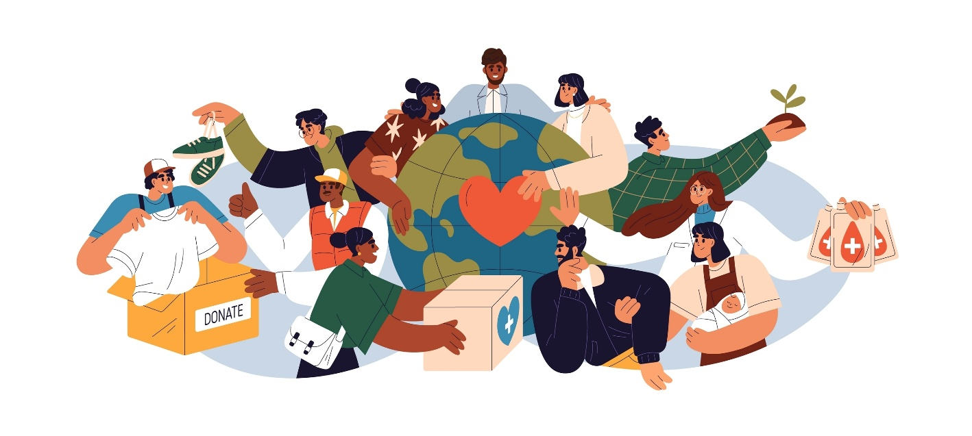
6
* Brand Vision
Your Reason for Being
SOCIAL PURPOSED
We want to be seen as a different kind of company – a company where our social-purpose creates strong and positive feelings for our brand.
If your brand exists for more than making money — if it embraces goals, aspirations, or a cause — that vision is a powerful part of your story.
ADVOCATE FOR SMALL BUSINESS
We want to be seen as a total advocate for the unique needs of small businesspeople and entrepreneurs.
HELPING STARTUPS LAUNCH
We help people who have been laid off, burned out, or desire to create second acts in life launch their dreams.

Slide 7

7
* Brand Drivers
Feelings that Make Your Brand Relevant
We’ve got your back to help you succeed.
These are the key features and emotional benefits that differentiate our brand.
The Drivers are what make customers fall in love with our brand.
CHATTY HAS YOUR BACK
PROJECT A PROFESSIONAL IMAGE
With no minimums, you pay only for what you use.
Lean on Chatty as your most trusted team member.
She wants you to succeed and works to make that happen.
We want to see you succeed because small businesses and entrepreneurs represent the heart and soul of America
Look bigger than you are with Chatty.
Chatty is a key player to achieve your business goals.
LEVERAGE WORLD CLASS INFRASTRUCTURE
CULTURE OF SERVICE
You don’t have to be big to enjoy a big-time call center.
Our capacity-sharing technology gives small businesses direct access to world-class customer service.
You don’t have to be big to enjoy a big-time call center that delivers insightful analytics
Our capacity-sharing technology gives small businesses direct access to world-class customer service.
We have a mission to do good in the world
Profits are donated to charitable causes
Our passion for fostering human connections reflects our Christian culture of service

Slide 8


8
* Brand Character
The Personality Behind the Brand
WE’RE FRIENDLY
This is how we define our brand in human terms. Our personality shapes the look, feel, voice and tone of communications and product design.
It’s our job to take your calls in a friendly, upbeat manner. Our brand is friendly and upbeat, too.
WE’RE RESPONSIVE
We treat your customers as our own. We bend over backwards to fit with the way you do business.
WE’RE EASY
Everything about doing business with Chatty is designed to make your life simpler.
WE’RE SERVICE-DRIVEN
We’re motivated to serve a higher calling, and it rubs off on our culture and brand. We treat our people right and do the same for people in need.

Slide 9
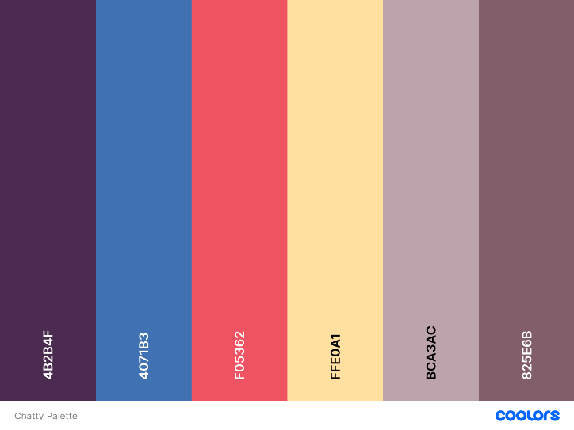





Your brand’s visual identity can make you look authoritative and bigger than you are – or appear friendly and accessible.
9
* Brand Look
Look as big as you want to be.
We use illustration to keep our look light, friendly and easy to use.
“Thanks, CHATTY . You make me look good.”
When we use photos, it is for a “behind-the-scenes” view
Meet Niesha She loves taking care of our customers.

Slide 10
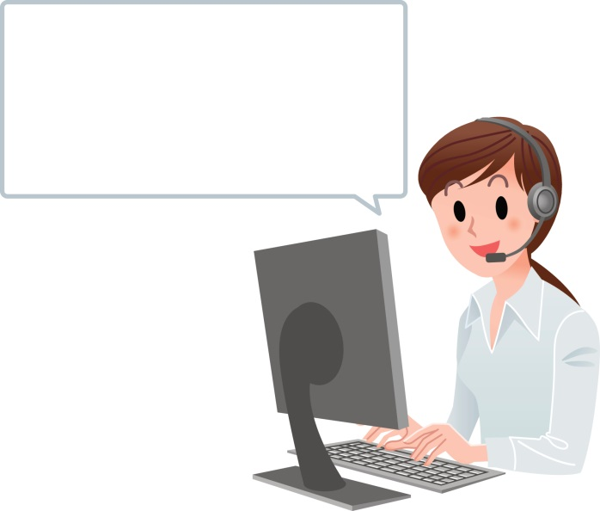
10
* Brand Rituals
Our trademark warmth.
We speak with our clients in a personal, relatable way.
“Good morning, Sue. How’s the weather in Fargo?”
“Happy Monday…”
“Dan, you got several leads this afternoon – high five!”
Good morning, Jim. How’s the weather?
Afternoon, Sue. Lots of calls -- people are responding to your promo!

Slide 11
11
* Brand Voice
Get everyone speaking the same style and tone.
CHATTY SPEAKS LIKE A REAL PERSON
This is how our brand speaks to our audiences. Brand Voice defines how language is used in all messaging.
“Hi, I’m Chatty. When I start handling your incoming calls, your workday will get a lot more productive.”
WE CAN BE A LITTLE SASSY
“You didn’t get into business just to answer the phone. Get out there; make good stuff happen. We’ll handle the front office”
“I’m here to help your day get a lot more productive…
WE CARE ABOUT YOU
“We’re looking out for you, so that you look good to your customers and prospects. It can be our little secret that Chatty is part of your team.”
AND WE CARE ABOUT THOSE MOST IN NEED
“We’re all about doing good – doing good for your business and for those most in need. That’s why we donate our profits to charity.

Slide 12
* MESSAGING
Tag Line
12
Chatty
Your Personal Receptionist ON DEMAND
Options
On Demand Virtual Reception
Your pay-as-you-go Personal Receptionist
Your virtual front office – without the cost

Slide 13
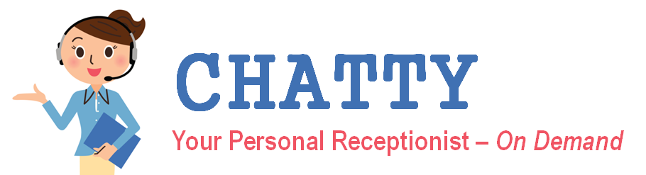
* MESSAGING
Value Propostion
13
These high-level phrases should appear in our marketing copy.
MOST AFFORDABLE
No monthly minimums
TRUE VALUE
A fraction of the cost of an in-house receptionist
BUSINESS ADVANTAGE
A live receptionist captures more leads, closes more sales and projects a professional image.
PROVEN SOLUTION
Chatty leverages the Servantus certified call center infrastructure
SERVICE-DRIVEN
It is our mission to serve – both by serving our customers and by giving our profits to charity.

Slide 14
* MESSAGING
Elevator Pitch
14
If you’re out in the field and an important call comes in, what is the customer experience?
[Prospective customer describes voicemail]
You just described a missed call, and missed calls cost you customers. Every business your size has this issue.
Imagine you are the prospect making the call, and you are greeted by a warm, attentive professional who understands your business and gives you the confidence that your needs are important.
[answers: “That would be fantastic]
I don’t have to explain how your voicemail machine is costing you customers.
Chatty Reception fills a unique niche for solo entrepreneurs. We provide friendly, US-based virtual receptionists who answer your incoming phone calls, 24 hours a day, just as if they were in your office!
Chatty is more than a convenience. What if I could show you how we can grow your business?
We capture 1.6 million sales leads per year – all potential revenue.
Our average answer time is under 10 seconds
And we filter those annoying robocalls and spam – those calls cost you big time in productivity and distraction from your work.
One more question: Do you ever take time off? Golf, doctor, vacation, the gym?
[answers]
How would it feel if you could take time off and know that your business is still being covered?
[answers]
Chatty is all about making life easier for small businesses. That’s why we’ve designed our virtual receptionist pricing to be the most straightforward and inclusive on the market. We have plans that begin at $250 per month. Compare that to adding someone to your payroll at $4,000 per month.

